Slide 1
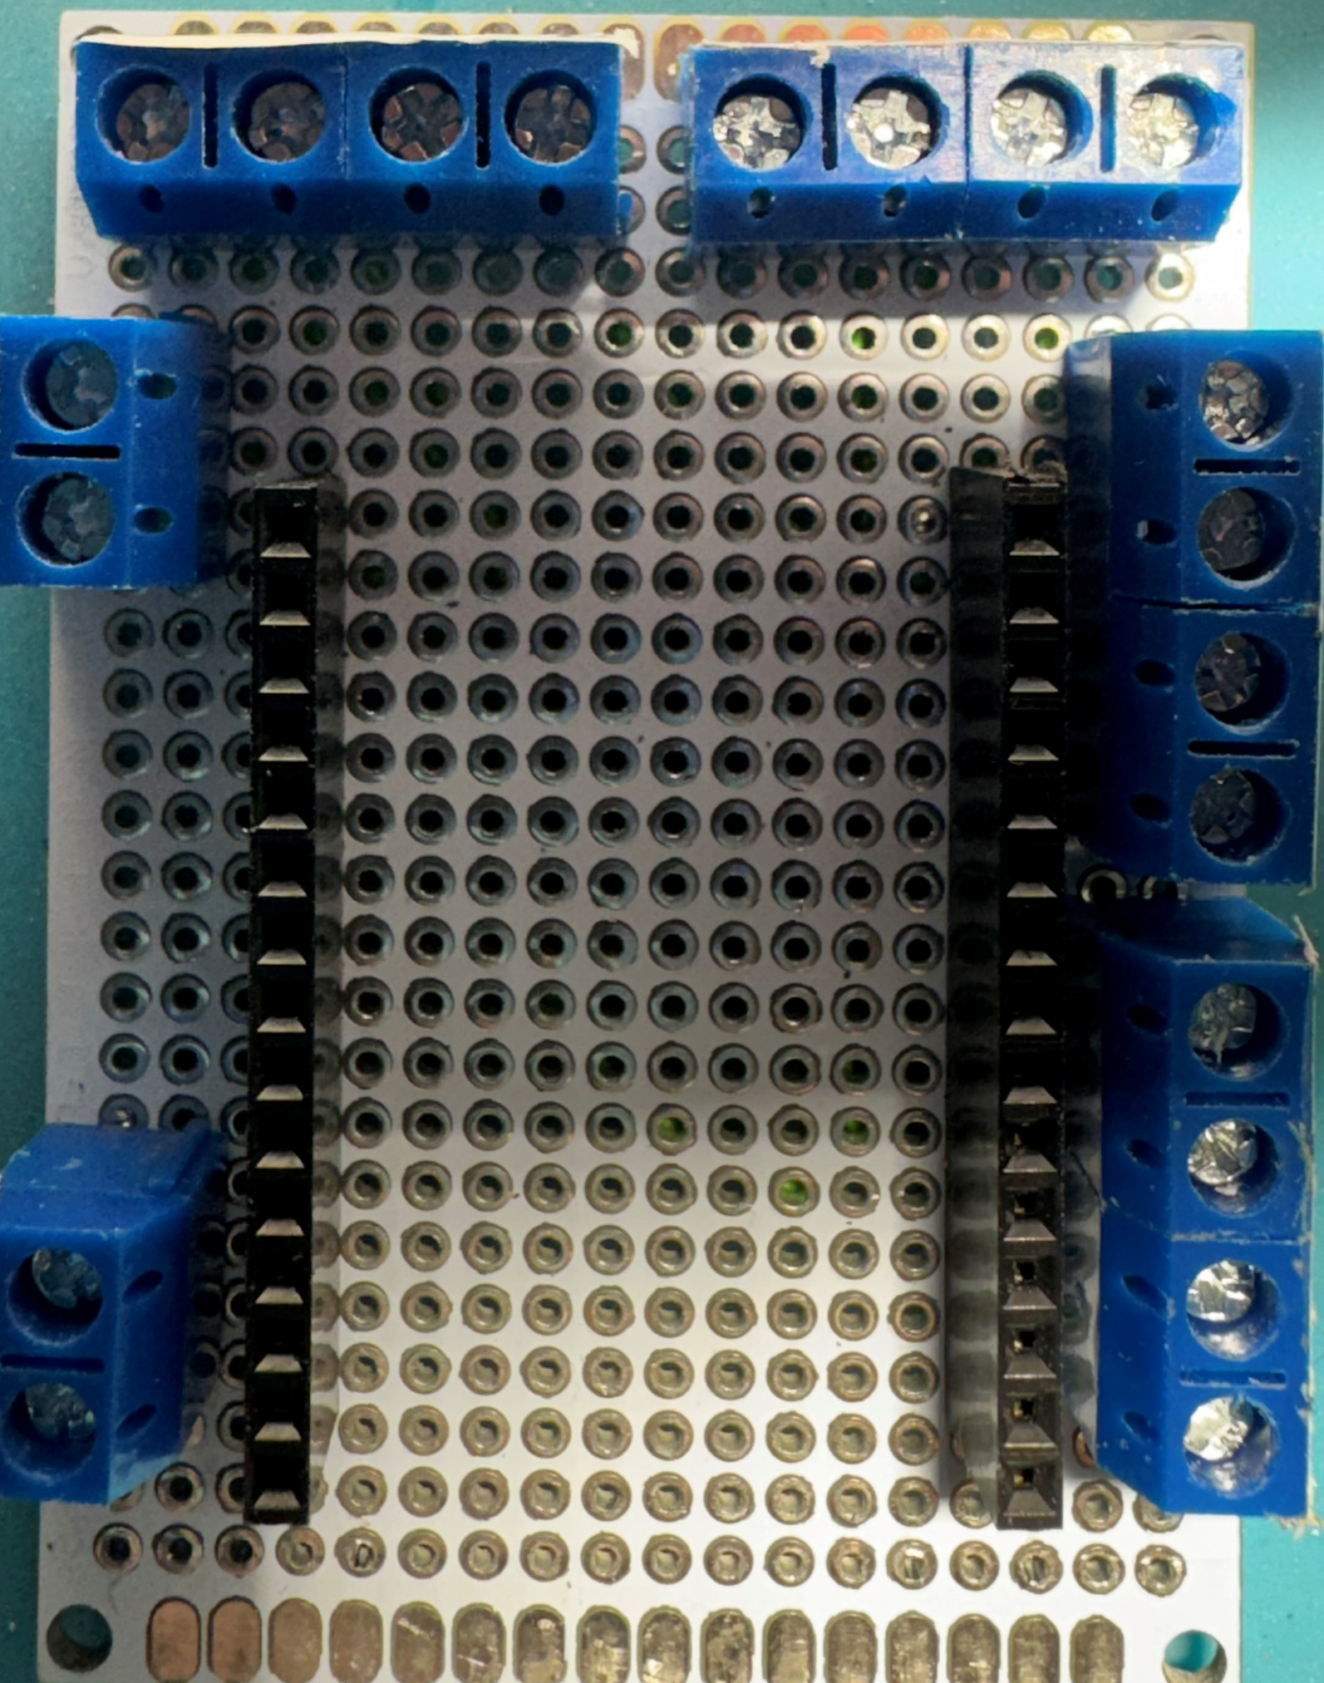
Button Left
Button Right
SW
LED
SW
Gnd
GPIO01
Gnd
GPIO05
Gnd
GPIO03
Gnd
GPIO16
Buzzer
GPIO14
GPIO04
I2C Display
sda
Gnd
GPIO00
scl
3v3
Gnd
Power
GPIO13
Scanner
Rx
GPIO15
Tx
Gnd
Gnd
5V
3v3

